Slide 1
Electricity Rates Notes
Development Notes for March 2016 Version of SAM

Slide 2
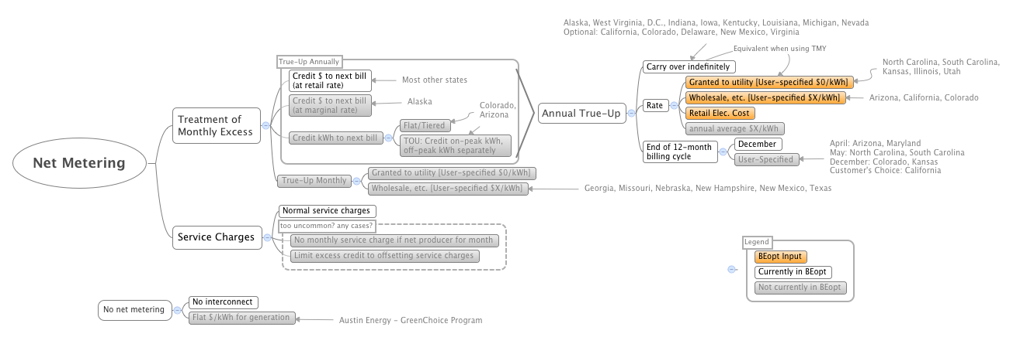
Net metering from Eric Wilson (ca. Jan 2015)

Slide 3
California Tiered TOU Rate Structures
Electricity Rates Notes

Slide 4
Transition Period through 2019
CPUC decision based on changes sought by SCE, PG&E, and SDG&E
Change staged over 5 years:
4 tiers: 1, 1.27, 1.67, 2.07
2015: 4 tiers 1, 1.34, 1.56, 1.94
2016: 3 tiers 1, 1.4, 1.76
2017: 2 tiers 1, 1.49; super user (4x baseline) 1.88
2018: 2 tiers 1, 1.44; super user 2.04
2019: 2 tiers 1, 1.25; super user 2.19; automatic TOU
Source: The Desert Sun, Sammy Roth, July 7, 2015

Slide 5
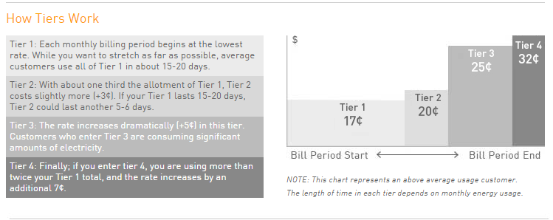
Tiered Rates
Tiers accumulate over the month
PG&E “Tiered Base Plan” http://www.pge.com/en/myhome/saveenergymoney/plans/tiers/index.page

Slide 6
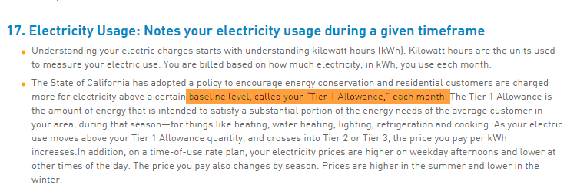
Tiers are monthly
PG&E “Understand My Bill, Electric Time of Use Statement page 3”
http://www.pge.com/en/myhome/myaccount/explanationofbill/etoub/3/index.page

Slide 7
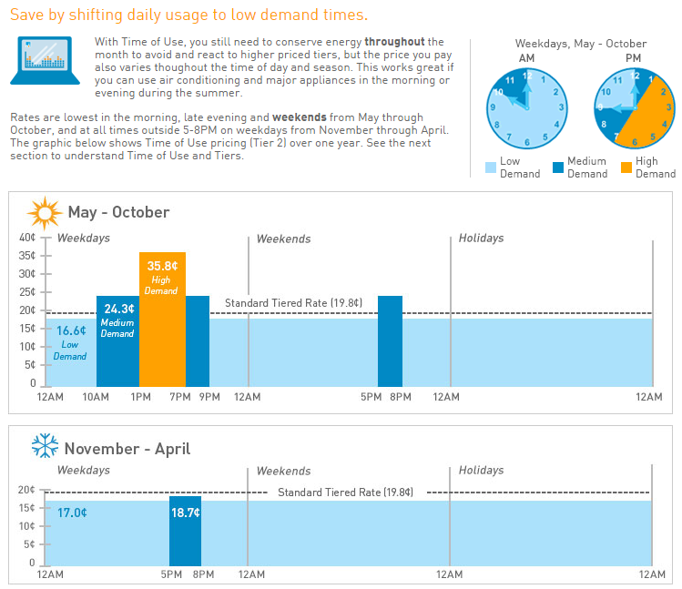
Time of use Rates
one day
PG&E “Time of Use Plan” http://www.pge.com/en/myhome/saveenergymoney/plans/tou/index.page

Slide 8
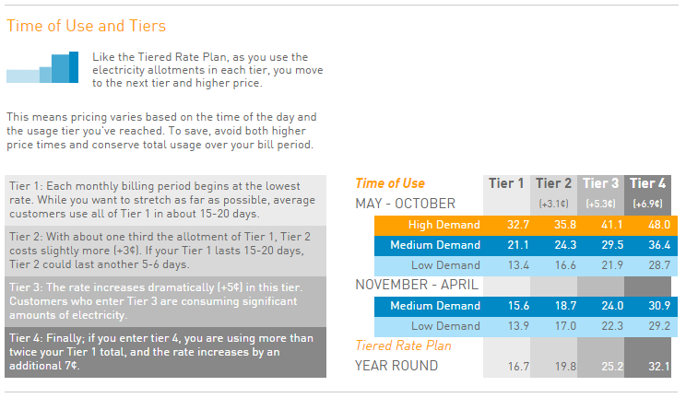
Tiered TOU Rates
Rates in cents/kWh
PG&E “Time of Use and Tiers” http://www.pge.com/en/myhome/saveenergymoney/plans/tou/index.page

Slide 9
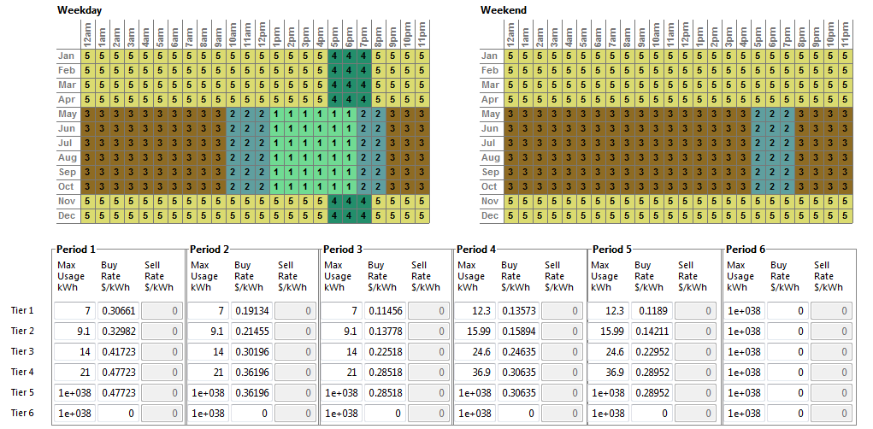
Tiered TOU Rates
TOU charges distributed across tiers.
In a given month, you don’t move to next tier until the you exceed the tier’s allocation.
For each month:
For Tier 1
Usage under 7 kWh/day billed at T1 rate for the appropriate period
Usage over 7 kWh/day and under 9.1 kWh/day billed at T2 rate for the appropriate period
...
For Tier 2
...

Slide 10
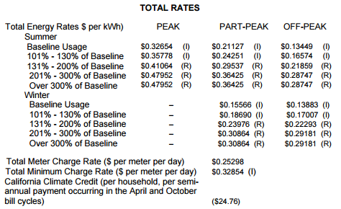
Assignment of charges to tiers is on pro-rated basis
“On-peak, part-peak, and off-peak usage is assigned to tiers on a pro-rated basis. For example, if twenty percent of a customer’s usage is in the on-peak period, then twenty percent of the total usage in each tier will be treated as on-peak usage.”
Source: Rate sheet for PG&E Electric Schedule E-6 (Residential TOU service)

Slide 11
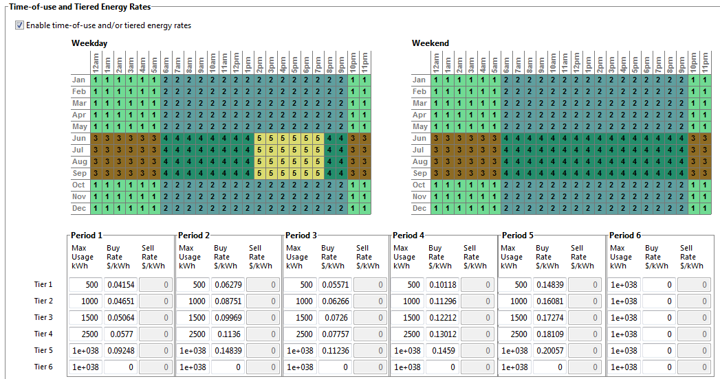
SAM 2015.6.30 Tiered TOU Rates
For each month:
For period 1
Usage under 500 kWh billed at Tier 1 rate
Usage over 500 kWh and under 1000 kWh billed at Tier 2 rate
Usage over 1000 kWh and under 1500 kWh billed at Tier 3 rate
...
For Period 2
...
Austin Energy, Residential TOU

Slide 12
Example: Consumption and price for one month for rate structure with 2 Tiers and 3 TOU Periods
SAM 2015.6.30: Tiers accumulate within periods
California: Tiers accumulate over month
1. For each month, tally kWh per period
1. For each month, tally kWh per tier
2. For each period, tally kWh by tier
2. For each tier, allocate kWh to periods
$/kWh
3. Assign price to blocks
3. Assign price to blocks
$/kWh
kWh
kWh
Tier 1
Tier 2
Period 1
Period 2
Period 3

Slide 13
SAM 2015.6.30: Tiers accumulate within periods
$/kWh
1. For each month, tally kWh per period
2. For each period, tally kWh by tier
3. Assign price to blocks
kWh
Tier 1
Tier 2
Period 1
Period 2
Period 3

Slide 14
California: Tiers accumulate over month
$/kWh
1. For each month, tally kWh per tier
2. For each tier, allocate kWh to periods
3. Assign price to blocks
kWh
Tier 1
Tier 2
Period 1
Period 2
Period 3

Slide 15
Example: Consumption and price for one month for rate structure with 2 Tiers and 3 TOU Periods
SAM 2015.6.30: Tiers accumulate within periods
California: Tiers accumulate over month
1. For each month, tally kWh per period
1. For each month, tally kWh per tier
2. For each period, tally kWh by tier
2. For each tier, allocate kWh to periods
$/kWh
3. Assign price to blocks
3. Assign price to blocks
$/kWh
kWh
kWh
Tier 1
Tier 2
Period 1
Period 2
Period 3

Slide 16
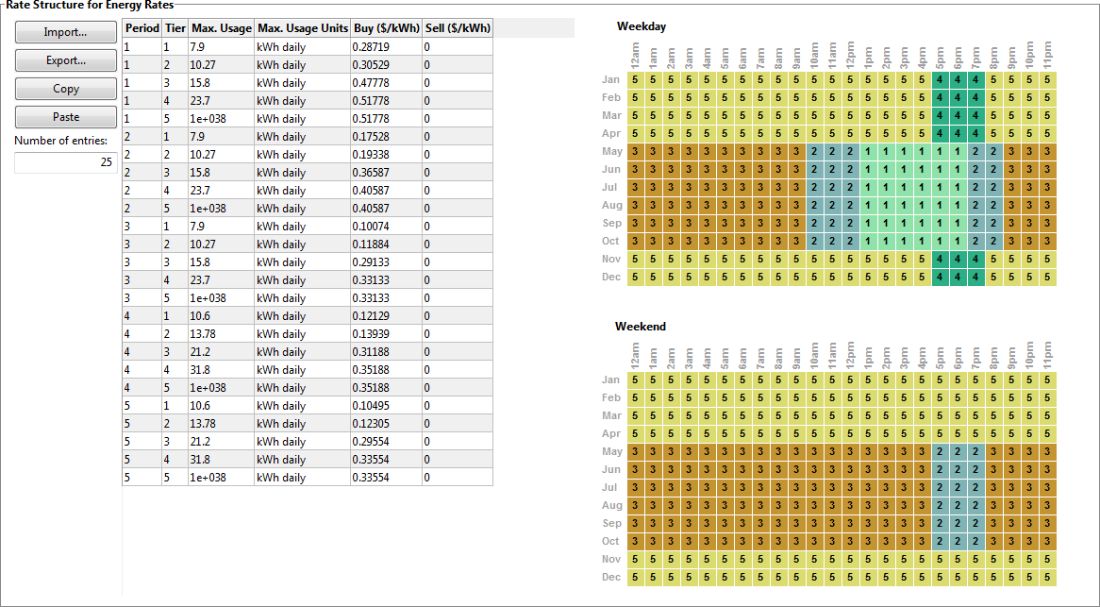
SAM 2016.3.14: Let’s have some fun! PG&E Residential E-6 Baseline Region Z

Slide 17
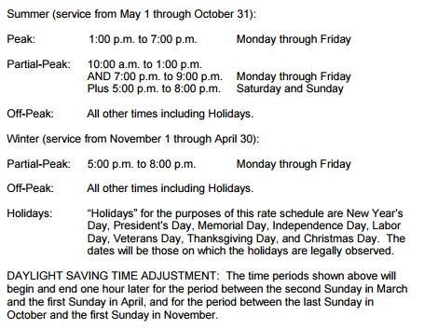
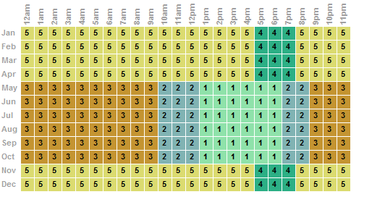
Problem with TOU periods and kWh rollover across season
Partial Peak
Off Peak
Off Peak
Peak
Note that the rate sheet defines changes in TOU period definitions for 2021 and 2022
Partial Peak
SAM does not know how to map period numbers to peak, off-peak, partial-peak periods
Definitions are different for different utilities and rate structures (and in this case, the present and future)

Slide 18
Steve’s guessing game
April to May:
12 am = TOU 5 to 3
6 am = TOU 5 to 3
12 pm = TOU 5 to 2
6 pm = TOU 4 to 1
Therefore:
TOU 5 to 3 (off peak to off peak)
TOU 4 to 1 (partial peak to peak)
Partial Peak
Off Peak
Off Peak
Peak
Peak
October to November:
12 am = TOU 3 to 5
6 am = TOU 3 to 5
12 pm = TOU 2 to 5
6 pm = TOU 1 to 4
Therefore:
TOU 3 to 5 (off peak to off peak)
TOU 2 to 5 (partial peak to off peak)
TOU 1 to 4 (peak to partial peak)
Partial Peak

Slide 19
Eric’s sage advice
I think California and most states with net metering do $ rollover instead of kWh rollover, so this may be a specific question for Con Edison
Also interesting to see that they don’t recommend TOU rates for net metering customers, maybe because it gets so complicated

Slide 20
Net metering with TOU in URDB
URDB has “Assume net metering (buy = sell)” field (yes/no). That field is blank for the CA rates we are investigating
For two PGE (Portland) residential rates, one TOU and one flat, assume net metering is yes

Slide 21
What to do?
User must choose correct metering option because that info is not in URDB
Proceed with Steve’s 12a,6a,12p,6p approach for now?

Slide 22
NEM 2.0 and Nonbypassabe Charges
“Require customers on the NEM successor tariff to pay the nonbypassable charges that are levied on each kilowatt-hour (kWh) of electricity the customer obtains from the IOU in each metered time interval, regardless of the monthly netting of the kWh obtained from the IOU and exported to the grid by the customer;”
http://docs.cpuc.ca.gov/PublishedDocs/Published/G000/M158/K060/158060623.pdf

Slide 23
Non-California Rate Examples
Electricity Rates Notes

Slide 24
Examples of Tiered Rates
Salt River Project E-61 (commercial) has 9 periods (but no tiers)
Rocky Mountain Power (Utah) has tiers that accumulate monthly
Are there rates with daily/kWh tiers that use a different method than California’s baseline method?

Slide 25
Portland General Electric: Net metering billing, kWh credit for extra generation with TOU
Meters subject to Time of Use rates will be credited as follows: First, generation will be credited in the time period in which it was generated. If there is more generation than consumption in any time period, crediting will continue beginning with the highest rate period first and then continue to lower rate periods, until all generation has been credited. If any generation remains after the crediting process for a meter, it will be applied to lower ranked meters within that month and then to the following month, subject to the processes and annual billing cycle limitations described previously.
https://www.portlandgeneral.com/-/media/public/documents/rate-schedules/sched_203.pdf?la=en

Slide 26
Alabama Power Rate PAE: Purchase of Alternate Energy
Payment of energy is defined as a per kWh payment by the company to the customer
Payment for energy Option A Standard Rate
June to September: 3.16 ¢/kWh for all kWh
October to May: 2.88 ¢/kWh for all kWh
“If the Customer's credits for energy delivered exceed the Company's charges, the Customer’s account will be credited and such credits may be carried forward.” (p. 4)
Rules document mentions “metering equipment necessary to meter two-way electric energy flow in excess of metering” (p. 2)
Not clear what the time period for calculating excess is, but appears to be monthly.
http://www.alabamapower.com/residential/pricing-rates/pdf/PAE.pdf http://www.alabamapower.com/residential/pricing-rates/pdf/sp-pae.pdf

